Slide 1

Meraki SSID Dashboard
GVE DevNet
Global Sales Segment : Global Enterprise
Industries : Manufacturing
LoB : Operations Automation
Architectural Plays : Enterprise
Sales Plays : Other
Charles Llewellyn
Technical Solutions Specialist
September 2021
Notes:
Notes: If your use case applies to morer than one or even all industries please keep all the industries and BOLD the industry where the PoV fits.
Smart City/Health Care/Industry and Manufacturing/Hospitality/Education/Retail/Utilities/Logistics/Professional Services/Public Sector/Service Provider
For LoB applies the same : if there is just one LoB, delete others, and bold the LoB that PoV is about.
LoB ; Safe and Security/Operations Automation/Human Resources/Operation Analytics
Please only keep the Architectural Plays that PoV is about.
Architectural Play : Enterprise / Data Center / Security / Collaboration / Service Provider

Slide 2
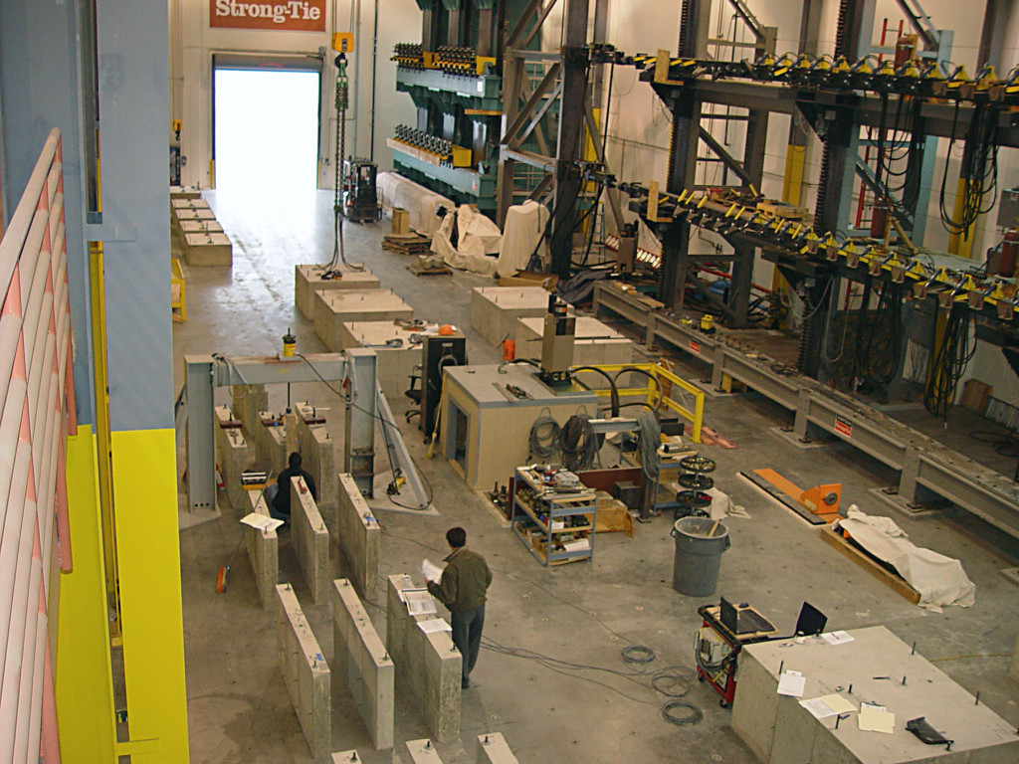
Manufacturing
Operations Automation
Notes:
Please under Industry Alignment just types the Industry that PoV was created as well LoB
For the pictures, when you go to the bx.cisco.com link and select brand categories and the select photograpy you can use the engine text box to look for industry pictures and download it

Slide 3

Meraki SSID Dashboard
Business Needs/Challenges
Need: Customer needs a way to manage SSIDs throughout hundreds of locations.
Challenge: Has to make individual changes to SSIDs which take time and resources.
[Portal] - Business Case information
Solution
A dashboard that gathers all Meraki SSIDs and allows Creation, Updates, and the ability to read Individual or groups of SSIDs.
[Portal] – Introduction information
Business Outcomes
This solution allowed the Networking Team to easily Identify SSIDs, and update specific components of induvial or groups of SSIDs which saves them hours of time, reducing operation expenses.
Notes:
Notes :
At the top Select a short name of the PoV naming product or products involved
Insert the logo f the customer when applies (if it is a general use case ignore the insert logo)
For Business Needs/Challenges :
For bullet Need : Write a small sentence that in an objective way to express the problem to solve when you refer to this problem, avoid to use technical words, uses business language as C-Level
For bullet Challenge : Write the main challenge and drawback the customer has to solve the problem (also avoid technical words, make a message in C-Level)
Solution :
Describe in a small sentence what is the solution about to deal with the problem referred, again, please avoid to uses technical words and use C-Level language
Business Outcomes:
Use small paragraph to show the benefits and gains with the solution explained above, please avoide to uses technical words and use C-Level language

Slide 4




Meraki SSID Dashboard
Network Admin wants to update SSIDs
Network Admin selects SSIDs to update.
Network Admin updates selected SSIDs
Network Admin wants to update/create values on groups of SSIDs
Network Admin Selects SSIDs as golden config, and SSIDs to update with Golden Config’s Values
Updates or Creates SSID configuration based on selected “Golden Config” SSID. You can also compare the selected SSID with any SSID in the table.
Notes:
Notes :
Use this slide to explain the story around your solution. It is a prototype in high level point of view. Think about a explanation of your solution to an executive that does not know Cisco and deep dive technology
This slide it is also to share knowledge with a non-technical guy (like BDM or sales or C-Level) what is the solution about and how will work . You can do as many steps as you need to describe the main flow of the solution
LINK for Icons https://www.flaticon.com/

Slide 5
POV: Meraki SSID Dashboard
Customer / Opportunity
Simpson-Strongtie
What is the story? What was the business challenge?
Simpson-Strongtie spends a lot of time having to make small configuration changes on the same SSIDs across hundreds of Networks. They wanted a quick way to make batch changes so that they could reduce time spent on these configurations and focus more on other parts of their network.
What the PoV accomplished?
This PoV allows the Network Engineers to save countless hours on small configuration changes. This PoV also showed the Networking team the power of programmability in our Meraki portfolio.
[Portal] - What the PoV accomplished?
What are the benefits to the customer?
Saves on Operating Expenses, Allows engineers to focus on more critical issues.
Notes:
Notes :
*** From the side to the rest you can use all technical wording and reference from Cisco APIs, integrations and tools
Please fill the slide thinking about technical people and the scope of this PoV (what it is cover from the solution proposed and if there is a limitation or need a special integration to be awared
Align the bullet
What are the benefits to the customer?
With the Business Outcomes that you explain in the business case slide. And also you can add technical benefits on this slide or future steps to be added later as following steps

Slide 6
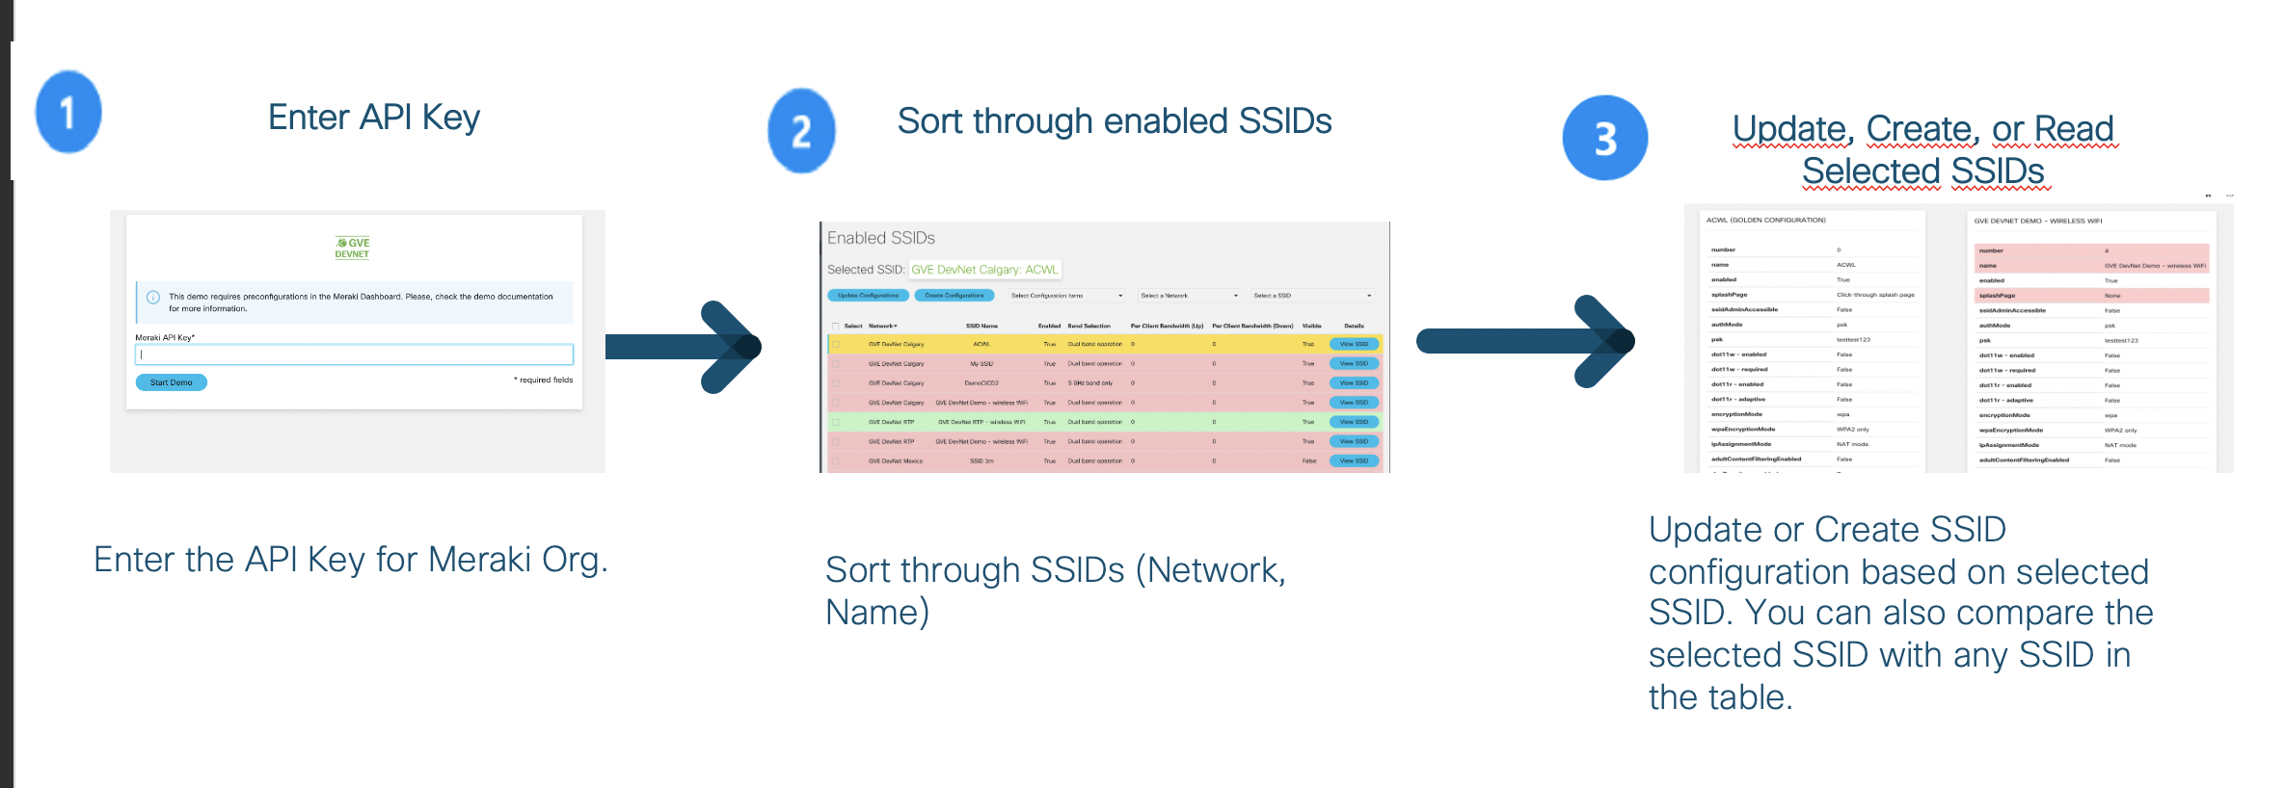
High Level Design PoV
Add link to the github repository [Portal Link]
Notes:
Notes:
Describe the High level design and flow for the PoV and mentioned the tools used
Do not forget to add the link to github repository or other specifcs needs

Slide 7
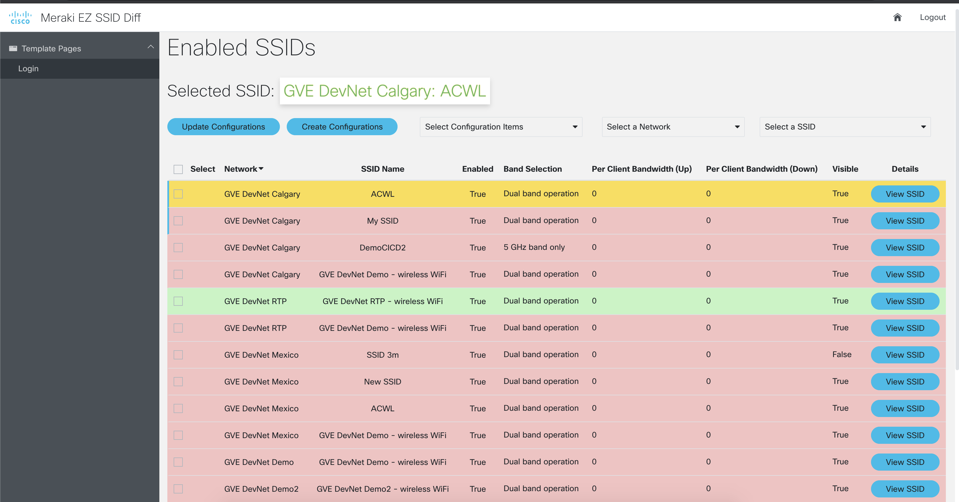
Show GUI or mockup
Notes:
Notes :
Some of the PoVs are developed either Sandboxes from dcloud, devnet or customer premises lab.
In the case the PoV is execute under Customer Premises Lab and would be hard to replicate the PoV, Please record video with the Demo and add the link to it.

Slide 8
Tools (products) Used
[Portal] - List of products and tools used in project:
Tools and Products: Python, Flask, Docker/Podman, unicorn, wsgi, openssl
Notes:
Notes :
Describe all the tools,
If there is a need for a specific licenses or code versión or hardware specifications mentioned here

Slide 9
Check out the GVE Devnet team @
https://gve-devnet.cisco.com/
Open a GVE case @
https://cep.cloudapps.cisco.com/case

